Slide 1

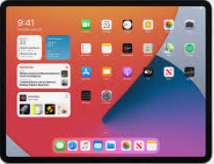
Online Safety Pupil Agreement

Slide 2
I promise:
To only use the school ICT for schoolwork that the teacher has asked me to do
Not to look for or show other people things that may be upsetting
To show respect for the work that other people have done

Slide 3
I will not:
Use other people's work or pictures without permission to do so
Damage the ICT equipment, if I accidentally damage something, I will tell my teacher
Share my password with anybody. If I forget my password, I will let my teacher know
Use other people’s usernames or passwords
Share personal information online with anyone
Download anything from the Internet, unless my teacher has asked me to

Slide 4
I will:
Let my teacher know if anybody asks me for personal information
Let my teacher know if anybody says or does anything to me that is hurtful or upsets me
Be respectful to everybody online; I will treat everybody the way that I want to be treated

Slide 5
I understand:
Some people on the Internet are not who they say they are. Some people can be nasty. I will tell my teacher if I am ever concerned in school, or my parent/guardian if I am at home
My school will monitor the websites I visit
If I break the rules, there will be consequences of my actions and my parents will be told

Slide 6
How can I make sure I follow the rules?
Is there anything that you don’t understand?
Who can you ‘TELL’ if you need help>

Slide 7


